Slide 1
From raw data to phenotype

Slide 2
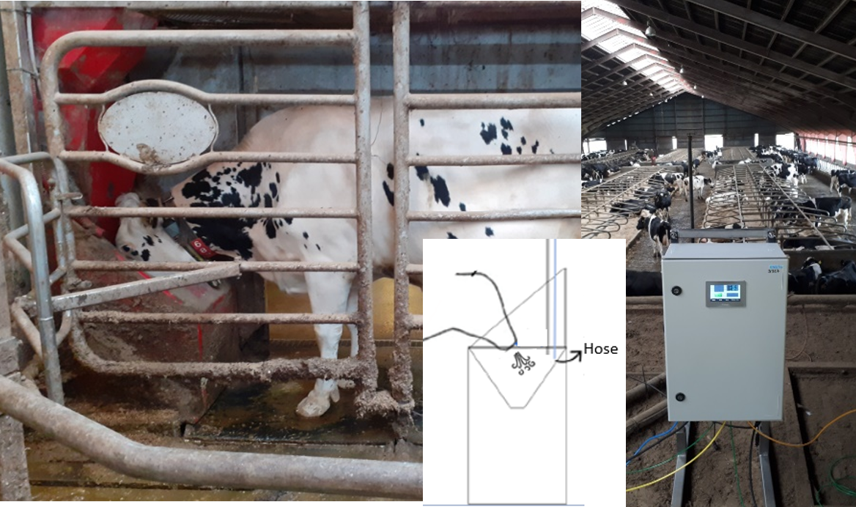
Methane Sniffer
Pros:
Relatively cheap –cost effective
Not invasive
Many records
5/25/202628/08/2023

Slide 3
Methane Sniffer
Pros:
Relatively cheap –cost effective
Not invasive
Many records
Cons:
Concentration not volume
Only AMS
Snapshots
Messy data
Affected by environment
5/25/202628/08/2023

Slide 4
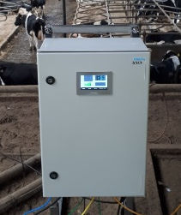
Large amounts of Messy data
~ 86,000 methane records/day/sniffer

Slide 5
Large amounts of Messy data
~ 86,000 methane records/day/sniffer
Automatized pipeline to clean data

Slide 6
Large amounts of Messy data
~ 86,000 methane records/day/sniffer
Automatized pipeline to clean data
High-quality dataset with gas concentrations
that can be converted to methane phenotypes

Slide 7
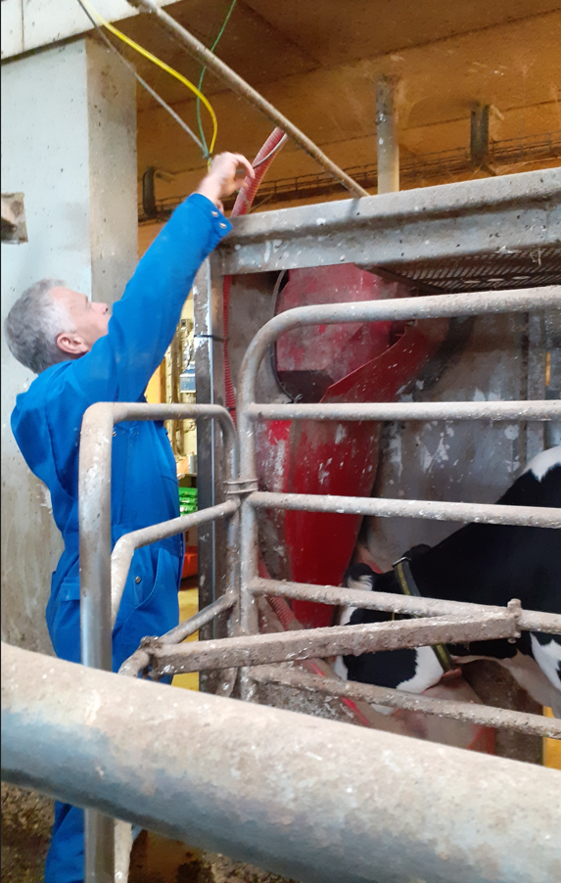


Need good technicians!
Setting up/moving equipment
Daily monitoring of data download
Checking up on equipment at irregularities
Fixing problems
Downloading AMS data
Managing database
Ordering parts

Slide 8



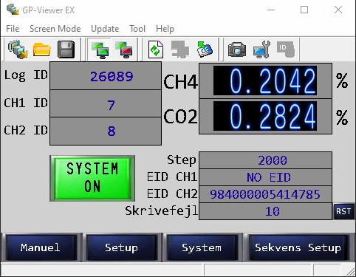
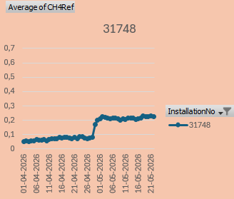
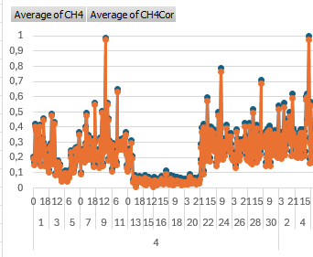
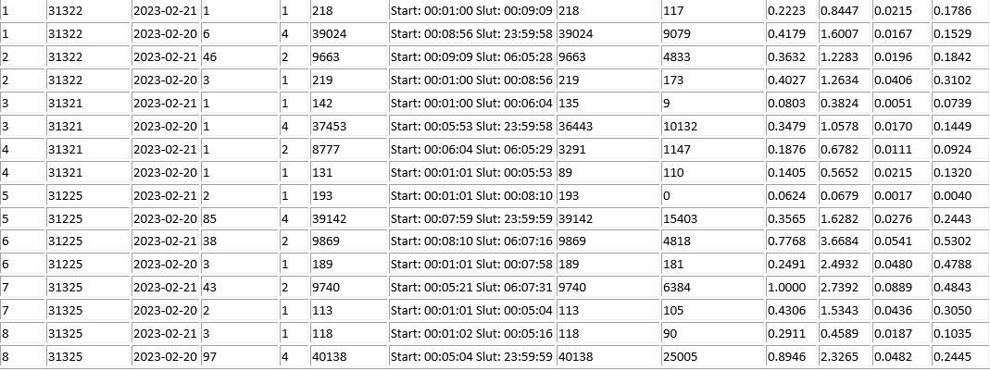
Manual Data monitoring
-Connection
- Number of exits from robot
- Max and mean gas values
- Standard deviations
-Reference measures

Slide 9
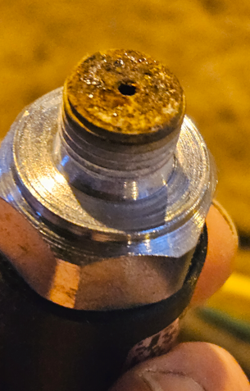

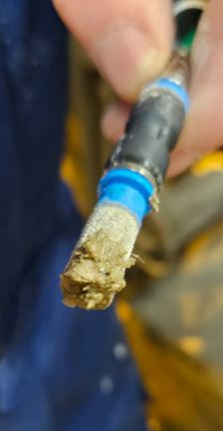
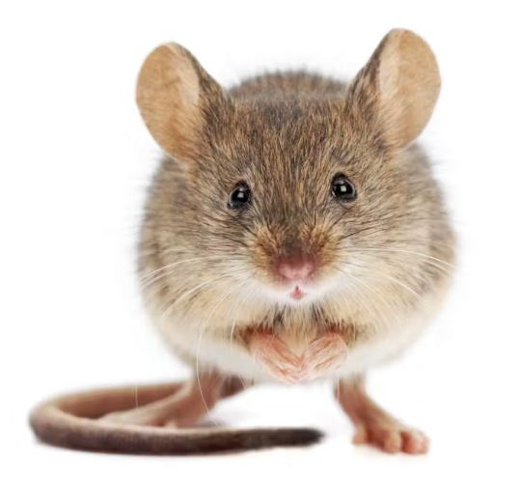
Equipment ”Errors”, examples
Notes:
The manual data monotoring finds the worst examples

Slide 10
Current data preparation
2- step procedure:
  Time alignment & quality control
  Phenotype creation

Slide 11
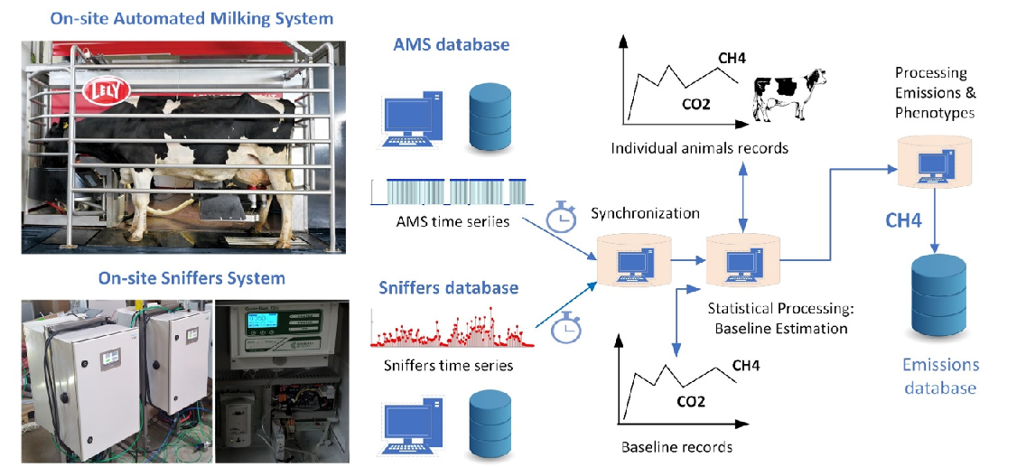
Automatized pipeline
Notes:
Two data streams

Slide 12
Automatized pipeline

Slide 13
Automatized pipeline

Slide 14
Automatized pipeline

Slide 15
Time synchronization & Quality control

Slide 16
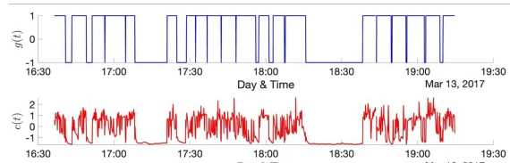
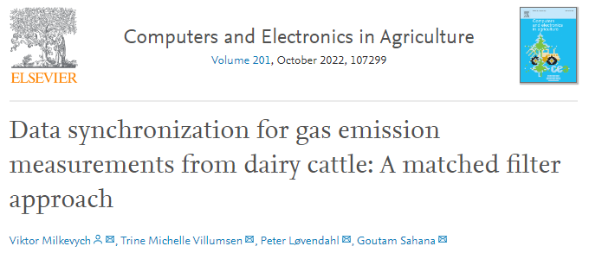
Time synchronization and quality control
Notes:
Finding best time match by sliding the CO2 concentration over the milking data –use CO2 for the alignment
Originally developed for time synchronization, because back in time the sniffer boxes did not synchronize to internet time.
This works now, but is still used for quality control, if cant be matched, data is discarded
Currently running one sniffer-Ams at a time but is currently being improves, since we have 38 sniffers with duplex setup,
If we cant find a clear pattern

Slide 17
Splitting records in cow and baseline
Notes:
After synchronization split in animal and baseline records

Slide 18
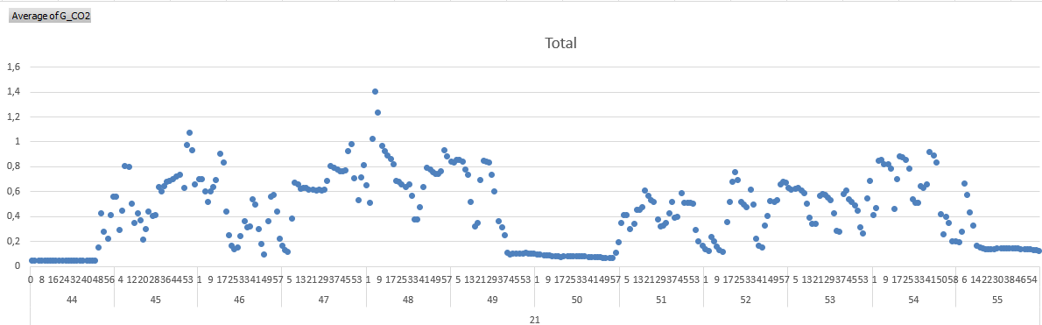
animal and baseline gas concentrations
Mikling periods: cow data
Non-milking periods: baseline data
baseline cow baseline cow baseline

Slide 19
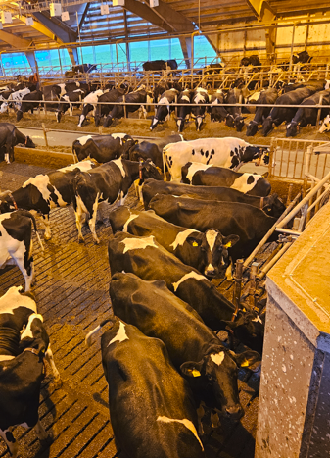
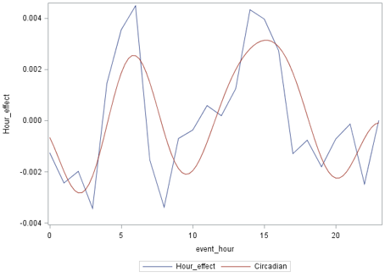
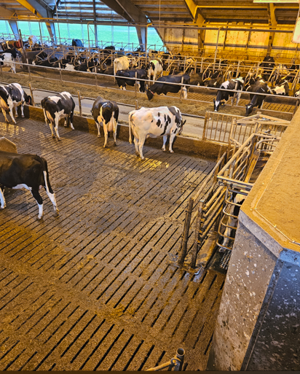
Baseline Gas concentrations
Baseline concentration modelling:
-AMS
-Date
-Time of day
-Duration of idle period
Notes:
Drift in calibration
Time of day
Also day to day variations depending on for instance weather

Slide 20
Individual animal records
Notes:
Now switch to animal records

Slide 21
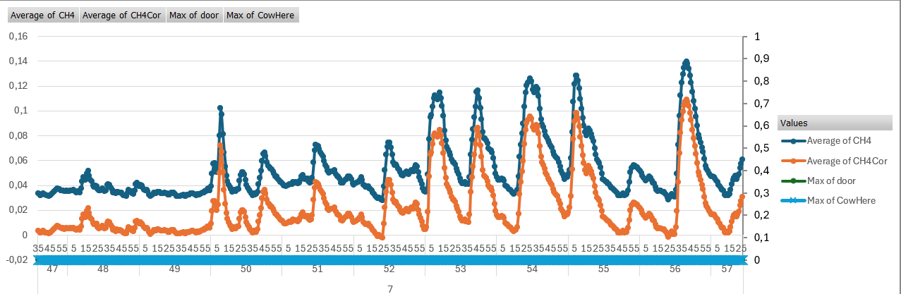
Records corrected for baseline
Gas concentrations are reduced after baseline correction
Notes:
This is a simple example how a cow’s methane is reduced after baseline correction

Slide 22
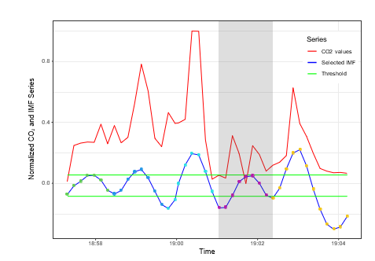
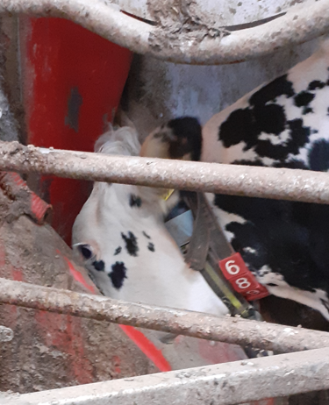
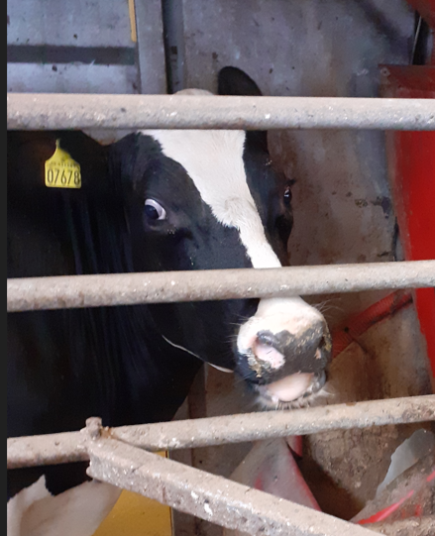
Filter for ”head lifting”
Only keep gas records where both methane and carbon dioxide are clearly higher than the normal background level
Indicate:
cow’s head is properly near the sensor/feed bin
measurements are reliable

Slide 23
Visit phenotype preparation

Slide 24
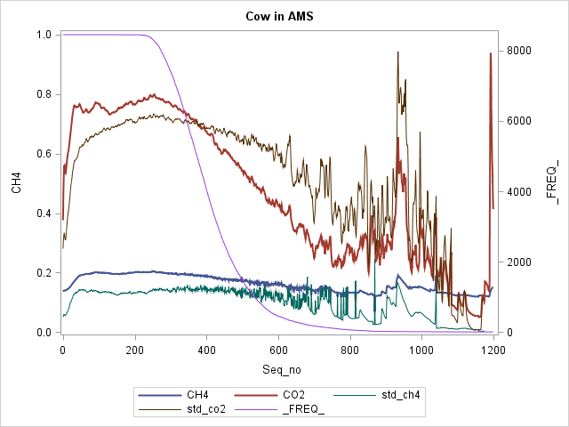
Pruning of early and late records
CH4 and CO2 from ~8000 milkings
Gas concentrations and std
CO₂
gas
CH₄
second

Slide 25
Pruning of early and late records
CH4 and CO2 from ~8000 milkings
Gas concentrations and std
Entrance
gas
second

Slide 26
Pruning of early and late records
CH4 and CO2 from ~8000 milkings
Gas concentrations and std
Entrance
More head lifting later on
gas
second

Slide 27
Pruning of early and late records
CH4 and CO2 from ~8000 milkings
Gas concentrations and std
Entrance
More head lifting later on
Best interval for visit phenotype
30-300 sec
gas
second

Slide 28

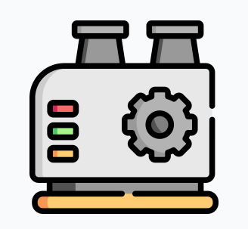
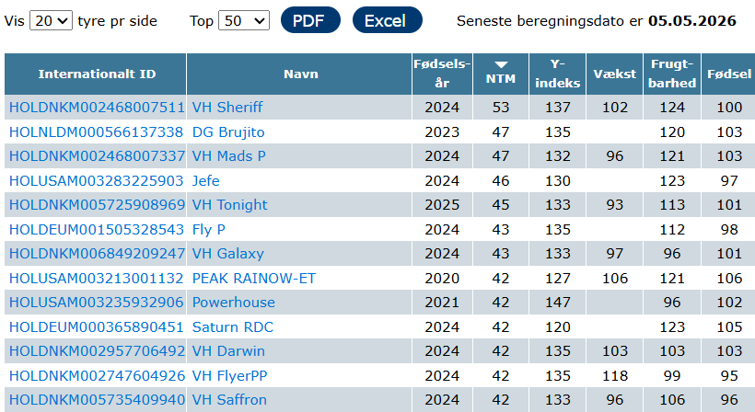

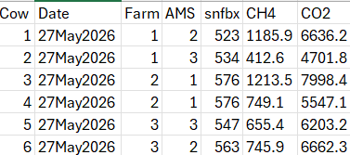
Upload to database for genetic evaluation
Notes:
Visits are uploaded to database, where they are transformed to daily records within AMS and sniffer.
And use pedigree and genomic information from NAV
And data from the Danish cattle database

Slide 29
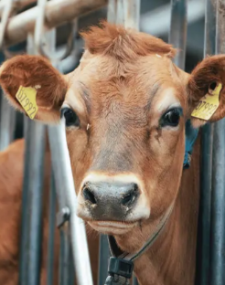
Future
1-step procedure including:
Automatic data transfer
Data monitoring with warning system
Time alignment and data quality control
Baseline estimation
Phenotype preparation
© VikingDenmark

